Slide 1
PLOTTING GRAPHS OF ACCURACY VS NUMBER OF CLIENTS

Slide 2
Plot of Accuracy Vs
No. of Clients
Details:
Optimizer used ='adam’,
loss='sparse_categorical_crossentropy',
metrics=['accuracy’]
Number of Rounds = 5 for all cases.
Plots only Accuracy for Clients: 2,3,4,5,6,7,8,9,10
Aggregation Strategy used="FedAvg"

Slide 3
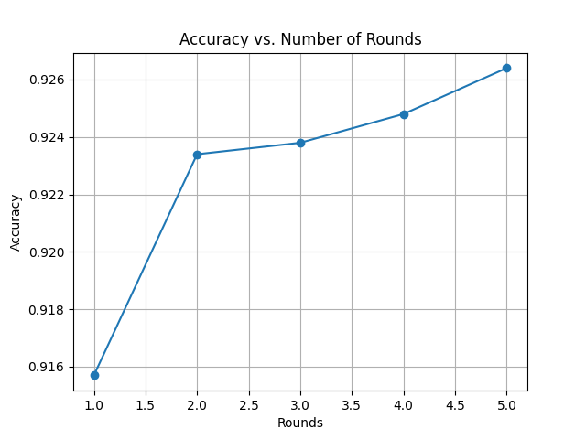
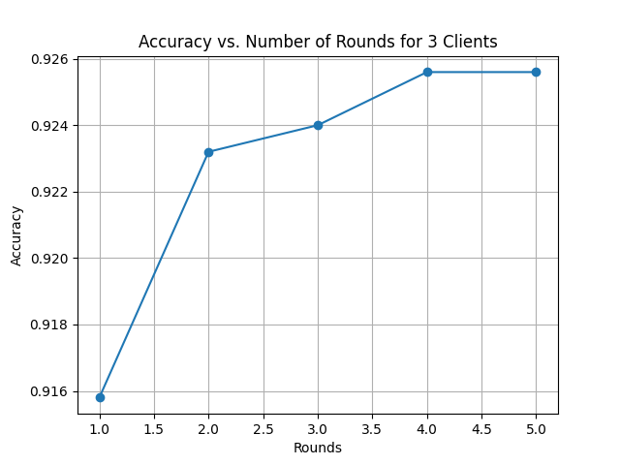
2 CLIENTS
3 CLIENTS

Slide 4
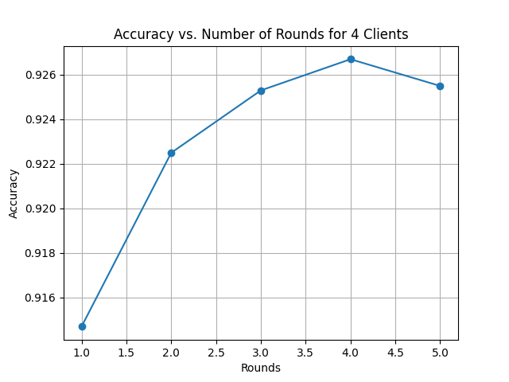
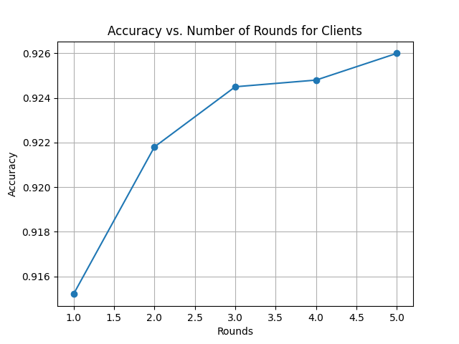
4 CLIENTS
5 CLIENTS

Slide 5
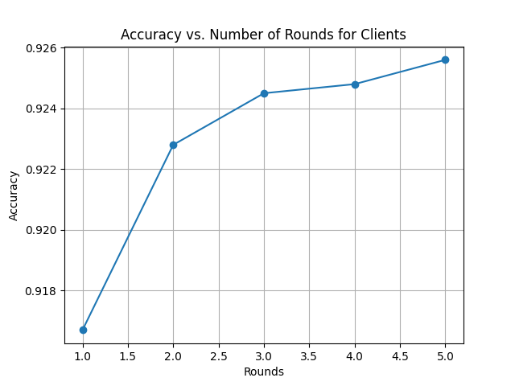
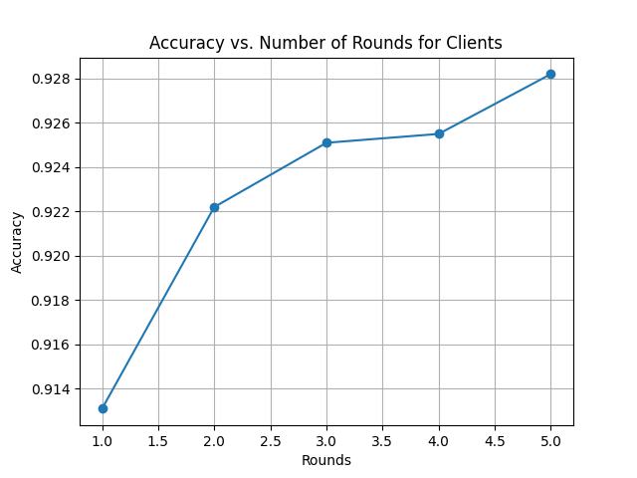
6 CLIENTS
7 CLIENTS

Slide 6
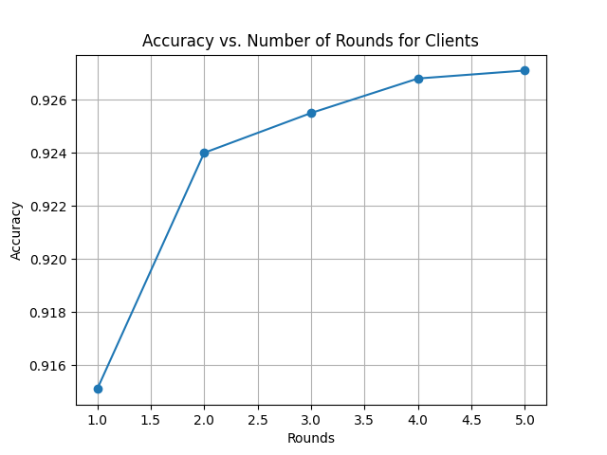
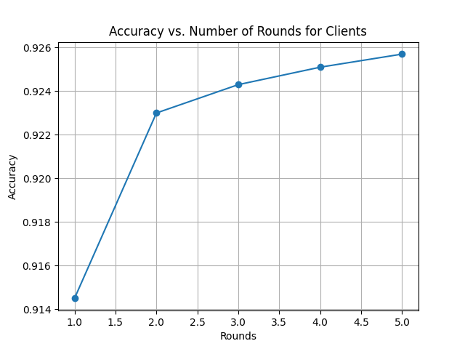
8 CLIENTS
9 CLIENTS

Slide 7

10 CLIENTS

Slide 8
KEY OBSERVATIONS
For Lesser Number of Clients i.e. 2 to 7, the slope is somewhat zig-zag and undulating. The accuracy suddenly decreases at some point and again increases. The graph is NOT smooth.
For higher number of clients( 8 to 10), the graph shows lesser changes with increase in rounds. The graph gets SMOOTHER.
Accuracy is maximum for 7 clients(0.928) but is near 0.926 for rest graphs.

Slide 9
PROBLEMS FACED
Time Complexity Increases with increase in number of Clients.
Not all the Clients are able to complete training for all 5 rounds. For example, while training for 8 clients, two clients ended up training for only 4 rounds and one client ended up training for 3 rounds, while the rest could successfully train for 5 rounds.
The system slows down for more no. of clients and some clients take too late to connect to the server.

Slide 10
CODE USED:
SERVER CODE:
import flwr as fl
strategy=fl.server.strategy.FedAvg()
#Start server
fl.server.start_server(
server_address="0.0.0.0:8080",
config=fl.server.ServerConfig(num_rounds=5),
strategy=strategy,
)

Slide 11
CLIENT CODE:
# Step 1: Import necessary libraries
import flwr as fl
import tensorflow as tf
import matplotlib.pyplot as plt
# Step 2: Loading dataset
(x_train, y_train), (x_test, y_test) = tf.keras.datasets.mnist.load_data()
# Step 3: Normalization
x_train, x_test = x_train / 255.0, x_test / 255.0
# Step 4: Define the Model
model = tf.keras.Sequential([
tf.keras.layers.Flatten(input_shape=(28, 28)),
tf.keras.layers.Dense(10, activation='softmax')
])
# Step 5: Compile model
model.compile(
optimizer='adam',
loss='sparse_categorical_crossentropy',
metrics=['accuracy']
)

Slide 12
CLIENT CODE:
# Step 6: Define the Client
class SimpleClient(fl.client.NumPyClient):
def __init__(self):
self.accuracy_list = [] # Store accuracy values after each round
def get_parameters(self, config):
return model.get_weights()
def fit(self, parameters, config):
model.set_weights(parameters)
model.fit(x_train, y_train, epochs=1, batch_size=32)
return model.get_weights(), len(x_train), {}
def evaluate(self, parameters, config):
model.set_weights(parameters)
loss, accuracy = model.evaluate(x_test, y_test)
self.accuracy_list.append(accuracy) # Append accuracy to the list
return loss, len(x_test), {"accuracy": accuracy}

Slide 13
CLIENT CODE:
# Step 7: Start the client and plot accuracy
client = SimpleClient()
def client_training():
fl.client.start_numpy_client(
server_address="127.0.0.1:8080",
client=client,
)
# Run client training
client_training()
# Step 8: Plot accuracy vs. number of rounds
rounds = range(1, len(client.accuracy_list) + 1)
plt.plot(rounds, client.accuracy_list, marker='o')
plt.title('Accuracy vs. Number of Rounds for 3 Clients')
plt.xlabel('Rounds')
plt.ylabel('Accuracy')
plt.grid(True)
plt.show()

